Slide 1
High Performance Stream Processing and Workflows with TPL Dataflow
Riccardo Terrell

Slide 2
High Performance Stream Processing and Workflows with TPL Dataflow
Riccardo Terrell
Notes:
I am excited for this talk, the TPL DF is a very powerful library that unfortunally I don’t see used as much as I would like.
The TPL was the answer, the right tool when I needed to designing a high-performance and parallel system where I did not want to compromise between code readability and high performant code and robustness of the code

Slide 3
TPL Dataflow … design to compose
TPL Dataflow workflow
for High throughput, low-latency scenarios
Process Task
Buffer
Input Data
Transform
Process Task
Aggregate
Transform
Output Data
Process Task
implementing tailored asynchronous parallel workflow and batch queuing
Notes:
what we will discuss... a little intro about what, why and when we should use the TPL DF, then we will check few of the more impotant building blocks and how to use them to implement some parallel dataflow and pipeline.
What is the TPL Dataflow?
First of all, what is a Dataflow? It is a programming paradigm that models a set of operations as a graph where data flows between those operations, and Most applications, real world application, are defined in this way as a series of functions operating on a common state.
so, a dataflow emphasizes the movement of data and it defines the inputs and outputs of these connected operations
At its core, the TPL Dataflow is a set of constructs built on top of task parallel library that can help us create a robust and declarative concurrent programs reducing a lot of complexity. A TPL Dataflow consists of one or more blocks, each block can be connected to another blocks to shape a pipeline, where our data move from one block who send the data which is called source to another block who receive the data which is called target. And these blocks are responsible to apply some behavior on the data that could generate data-transformation.
What is the complexity that the TPL Dataflow reduces, for example when we use other paradigms to make a program concurrent we should watch for share states. The synchronization to mange state that shared among multiple threads can make our code much more complicated, but Dataflow make this process easier… because It does not share state. Or it makes very hard to do so
it gives a framework on how to program avoiding the share of state.
And this leads to Compositionality, which is the main strength of the TPL DataFlow, because it uses a set of independent blocks that are designed to be combined. These blocks can be a chain of different tasks to construct a workflow that can easily parallelize, and are easily swapped, reordered, reused, or even removed.
Imagine you are implementing a complex workflow process that is composed of many different steps. It would be ideal to split the computation in blocks, developing each block independently, and then glue them together.

Slide 4
Divide and Conquer
Its about maximizing resource use
To get the best performance, your application has to partition and divide processing to take full advantage of multicore processors – enabling it to do multiple things at the same time, i.e. concurrently.
Notes:
This approach of breaking a part a big problem in smaller solutions, and then glue them back together is not a new idea. It is basic idea for building and structuring programs that can run concurrenlty. With the constrain that these small solutions are independent and possibly don’t share state.
For example, when a divide and conquer strategy is applied for a parallel computation, multiple threads work concurrently on different data partitions and different functions

Slide 5
When to use the TPL Dataflow
To process any workflow that can take advantage of Parallel Computation
Large amount of data to process and/or generate (Stream Data)
When taking advantage of batch processing by breaking up each section of an application
Notes:
Performance is a critical component of you application
Any time we need a Producer Consumer
Process large amount that can act like s stream of data…
And it provide Integration with RX
In modern application development, there are so many scenarios of dataflow processing, such large volume data processing, image/video conversion, data migration, etc.

Slide 6
Why TPL Dataflow?
Parallel and concurrent programming without Synchronization (avoid share of state)
Asynchronous programming evolution (for both I/O bound and CPU bound operations)
Reduce complexity of code structure (declarative)
Process seamlessly large data in parallel with low latency
Notes:
No more sync programming promoting async programming
The TPL Dataflow Library provides a foundation for message passing and parallelizing CPU-intensive and I/O-intensive applications that have high throughput and low latency.
Real world is composed of many autonomous things, TPL Dataflow structures the code closer to real problem domain , so it becomes easy to reason about your program
TPL Dataflow provides the tools to build, and fine-tune systems capable of processing huge data set and doing it efficiently.
The TPL DF
gives you explicit control over how data is buffered and moves around the system
improve responsiveness and throughput by managing efficiently the underlying threads
allows you to easily create a mesh of operations through which your data flows

Slide 7
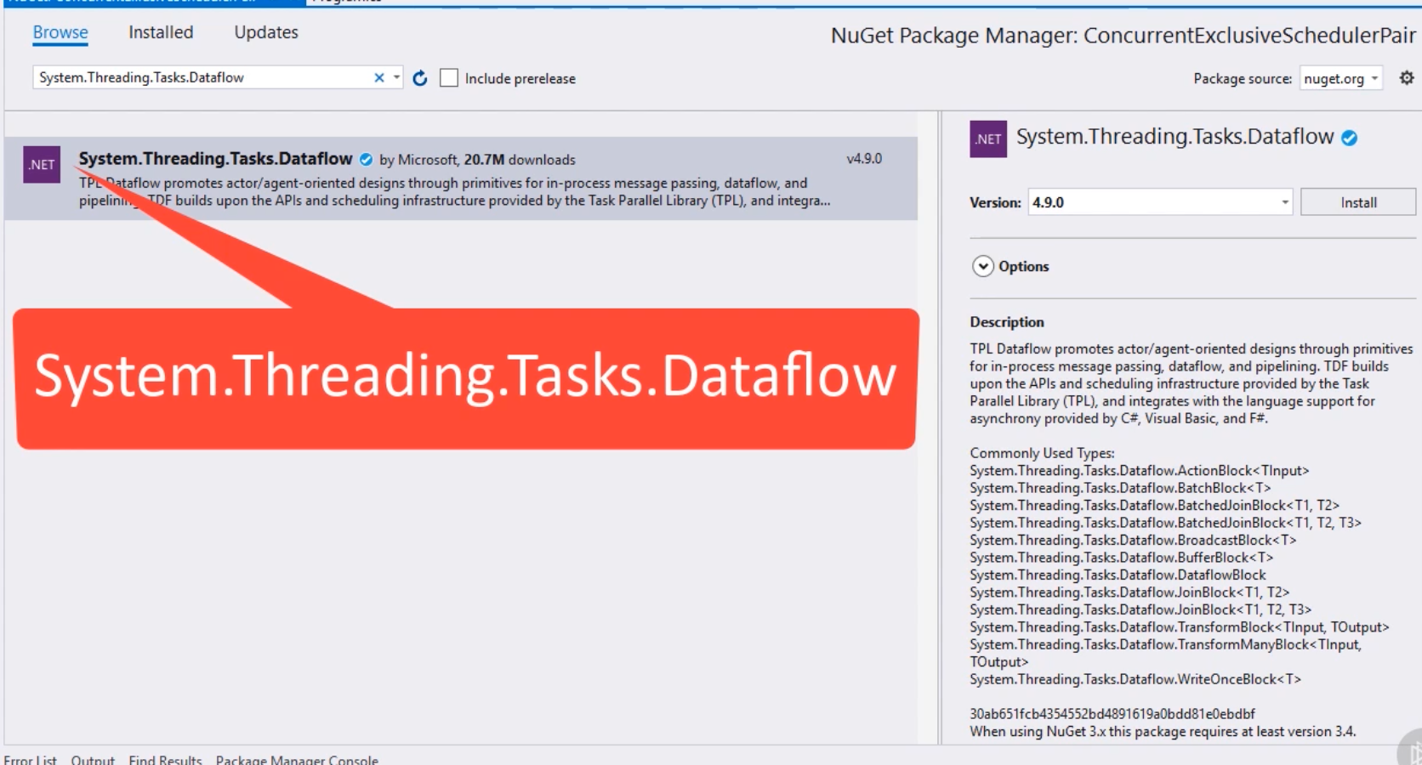
How to start?
TPL Dataflow
System.Threading.Tasks.Dataflow
Notes:
TPL Dataflow is a NuGet package published by Microsoft
Namespace System,Threading.Task.Dataflow
.NET Core friendly

Slide 8
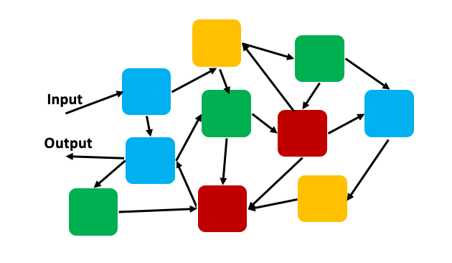
TPL Dataflow promotes Message Passing programming model
Notes:
The dataflow programming model is related to the concept of message passing, where independent components of a program communicate with one another by sending messages. Which are passed as input values
This programming model is also known as “share nothing”, because the blocks communicate using messages rather then sharing state
When we are sharing state in a multi-threaded program, we must use lock to synchronize the access of the shared resources, but : lock-based programs do not compose, we cannot take two atomic operations and create one more atomic operation out of them
Instead, because TPLDF tries to avoid the share of state, make it very hard and it promotes so Compositionality, which becomes very easy and declarative to do

Slide 9
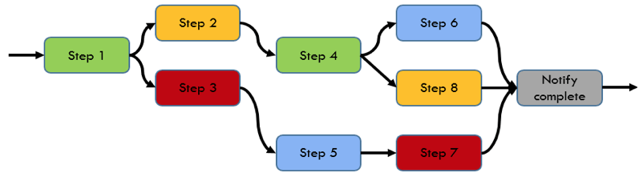
TPL Dataflow Architecture Building Blocks
Notes:
TPL Dataflow It’s a powerful and flexible library that implements the Dataflow and pipeline patterns in a thread-safe manner. As default the TPL DF is single threaded, but to introduce a degree of parallelism becomes a matter of configuration without any code changes.
And it supports different levels of parallelism, bound capacity and asynchronous API, which makes the TPL Dataflow a perfect candidate to implement the multi-threaded pipeline for both CPU and I/O bound operations.
TPL Dataflow foundation uses building blocks, we will see shortly how those blocks look and work, these components are useful when you have multiple operations that must communicate with one another asynchronously when you want to process data as it becomes available. In fact, one very important concept around the TPL Dataflow, is that is a push model rather then pulling, which also emphasizes the reactive aspect of this programming model.

Slide 10
TPL Dataflow Building Blocks

Slide 11
TPL Dataflow Architecture Building Blocks
public interface ISourceBlock<out TOutput> : IDataflowBlock
{
bool TryReceive(out TOutput item, Predicate<TOutput> filter);
bool TryReceiveAll(out IList<TOutput> items);
}
public interface ITargetBlock<in TInput> : IDataflowBlock
{
DataflowMessageStatus OfferMessage(
DataflowMessageHeader messageHeader, TInput messageValue,
ISourceBlock<TInput> source, bool consumeToAccept);
}
public interface IDataflowBlock
{
void Complete();
void Fault(Exception error);
Task Completion { get; }
}
Notes:
TPL Dataflow consists of “dataflow blocks,” data structures that buffer, process, and propagate data. They can be either sources, targets, or both, in which case they’re referred to as propagators.
These are the interfaces that the blocks implements. The main point here is that the Source Block Receive messages and acts as a source of data and can be read from, the Target Blocks Send or Offer a message and acts as a receiver of data and can be written to
~~~~
and there are blocks that are both source and target called propagator blocks and can be read from and written to
~~~
Source is a block that operates as producer of data, but it can also be read from.
Target is a block that acts as a consumer, which receives the data and can be written to.
Propagator is a block that acts as both a Source and a Target block.

Slide 12
BufferBlock<T>
Notes:
The BufferBlock<T> is the most fundamental block and it represents a general-purpose asynchronous messaging structure that provides an unbounded or bounded buffer for storing messages
This block stores the messages in a queue in a first in, first out (FIFO) fashion that can be written to by multiple sources or read from by multiple targets. This behavior makes this block a great tool for implementing easily sophisticated and high performant producer/consumer patterns.
In general, it is a good practice to have buffer blocks at the start and at the end of each sub-workflow.
When a target receives a message from a BufferBlock<T> , that message is removed from the message queue. Although a BufferBlock<T> can have multiple targets, only one target will receive each message. The BufferBlock<T> is useful when you want to pass multiple messages to another component, and that component must receive each message keep the order.
This block, like the others, support both synchronous and asynchronous operations.

Slide 13
N producer N consumers
Producer
Consumer
Producer
Consumer
Producer
Consumer
Notes:
Producer/consumer is a fundamental pattern employed in many parallel applications. With producer/consumer, one or more producer threads generate data that is consumed by one or more consumers. These consumers can themselves also be producers of further data, which is then consumed again by one or more consumers. And so on. This forms a pipeline, where each level of consumers represents another “stage” in the pipeline

Slide 14
BufferBlock<T> Producer-Consumer
static BufferBlock<int> buffer = new BufferBlock<int>();
async Task Producer(IEnumerable<int> values) { foreach (var value in values) buffer.Post(value); }
async Task Consumer(Action<int> process) { while (await buffer.OutputAvailableAsync()) process(await buffer.ReceiveAsync()); }
async Task Run() { await Task.WhenAll(Producer(Enumerable.Range(0,100),
Consumer(n => Console.WriteLine($"value {n}")));
}
Consumer
Producer A
Data
BufferBlock<T>
Input
Internal Buffer
Data
Producer B
Output
Data
Producer C
Notes:
The BufferBlock<T> can be thought of as an unbounded buffer for data that enables synchronous and asynchronous producer/consumer scenarios
In a traditional way, let’s say using a Blocking Concurrent collection, to balance the messages between both consumers and producers is not an easy thing to write and could lead to multi-consumers contention between threads and we could have the case where eagerly only one consumer ingests all the data, make starve the others. To fix this issue is possible, but it would require some more complex code
Thanks to TPL Dataflow, we solve it with just a few lines of code without any complex logic or changing the business code inside the blocks.
This is a simple example, we won’t have problems when sending 100 or more messages at the time that are processed quickly, but increasing the number to millions and changing the message to a real-life case will might hit some bottleneck issues

Slide 15
BufferBlock<T> Producer-Consumer
static BufferBlock<int> buffer = new BufferBlock<int>(
new ExecutionDataflowBlockOptions { BoundedCapacity = 100 } );
async Task Producer(IEnumerable<int> values) { foreach (var value in values) await buffer.SendAsync(value); }
async Task Consumer(Action<int> process) { while (await buffer.OutputAvailableAsync()) process(await buffer.ReceiveAsync()); }
async Task Run() { await Task.WhenAll(Producer(Enumerable.Range(0,100),
Consumer(n => Console.WriteLine($"value {n}")));
}
Consumer
Producer A
Data
BufferBlock<T>
Input
Internal Buffer
Data
Producer B
Output
Data
Producer C
Notes:
To solve this problem,
we will need simply to set the property called BoundedCapacity on ExecutionDataflowBlockOptions.
In addition, to avoid to loose messags in a high volume scenario, we need to replace the Post method, which sends the data into the block without blocking. Therefor, It will not wait until a block can accept a message. If a block can't accept the message it is discharged and the Post returns false. To overcome this limitation, the TPL Dataflow offers an extension method called SendAsync. This method returns a task onwhich we can await. All messages were processed, they were distributed to all consumers, and we are not running into the risk to have any bottleneck
This is just a little gatcha, use SendAsync

Slide 16
ActionBlock<T>
Action<TInput> delegate
Notes:
The TPL DataFlow ActionBlock is used to execute a given callback for any item sent to it. You can think of this block logically as a buffer for data combined with a task for processing the input values. In other words, the ActionBlock<TInput> block is a target block that calls a delegate when it receives data, similar to for-each loop, where the execution of the delegate is done asynchronously and it will by default process only one data element at a time, buffering the other data until the previous one completes

Slide 17
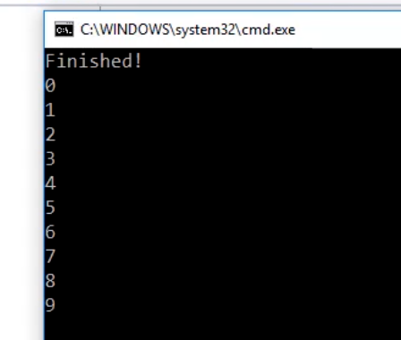
ActionBlock<T>
var actionBlock = new ActionBlock<int>(n =>{ Thread.Sleep(1000); Console.WriteLine(n); });
for (int i = 0; i < 10; i++) { actionBlock.Post(i); }
Console.WriteLine(”Finished!");
Notes:
Here we defined an instance of the action block where the constructor accepts a lambda, an action delegate, so a function with one input returning a void. Our function will just print what it received to the console. Next, we have a for loop that passes incremental numbers to the block using the Post method
The TPL Dataflow is asynchronously taking messages from the input queue and executing our function on each message until the input queue is empty.
Also, the TPL Dataflow blocks expose the input queue by providing an InputCount property that returns the total number of messages in the input queue.

Slide 18
ActionBlock<T> Sync and Async
// Downloading Images Sequentially and Synchronously var downloader = new ActionBlock<string>(url => { // Download returns byte[] byte [] imageData = Download(url); Process(imageData); }); downloader.Post("http://msdn.com/concurrency"); downloader.Post("http://blogs.msdn.com/pfxteam");
// Downloading Images Sequentially and Asynchronously var downloader = new ActionBlock<string>(async url => { byte [] imageData = await DownloadAsync(url); Process(imageData); }); downloader.Post("http://msdn.com/concurrency "); downloader.Post("http://blogs.msdn.com/pfxteam");

Slide 19
MaxDegreeOfParallelism
Action<TInput>
MaxDegreeOfParallelism = 2
Notes:
By default, an individual dataflow block processes only one message at a time, queueing all the not-yet-processed messages so that they may be processed when the currently processing message is completed. However, there are cases where we want to process messages as fast as possible, and is ok that multiple messages processed in parallel. To achieve this, we can set the MaxDegreeOfParallelism option.
Also note that MaxDegreeOfParallelism applies to an individual block, so each block can have a different degree of parallelism.
~~~
MaxDegreeOfParallelism also works if a block does asynchronous processing. In this case, each data item takes up a slot when the block begins processing it, and only leaves that slot when the asynchronous processing is fully completed.
~~~~~
The MaxDegreeOfParallelism option makes parallel processing within a block easy to do. What is not so easy is determining which blocks need it. One technique is to pause dataflow execution in the debugger, where you can see the number of data items queued up. This can be an indication that some restructuring or parallelization would be helpful.
If set to DataflowBlockOptions.Unbounded (-1), any number of messages may be processed concurrently, with the maximum automatically managed by the underlying scheduler targeted by the dataflow block.
Note that MaxDegreeOfParallelism is a maximum, not a requirement. Due to either the functional semantics of a given dataflow block or due to available system resources, a block may choose to execute with a lower degree of parallelism than specified. A block will never execute with a higher degree of parallelism. Also note that MaxDegreeOfParallelism applies to an individual block, so even if set to 1, multiple dataflow blocks may be processing in parallel. A TaskScheduler targeted by multiple blocks may be used to enforce policy across multiple blocks. For example, if two dataflow blocks are each configured to target the exclusive scheduler of a single ConcurrentExclusiveSchedulerPair instance, all work across both blocks will be serialized. Similarly, if both blocks are configured to target the concurrent scheduler of a single ConcurrentExclusiveSchedulerPair, and that pair has been configured with a maximum concurrency level, all work from both blocks will be limited in total to that number of concurrent operations.
Set a degree of parallelism for each step.

Slide 20
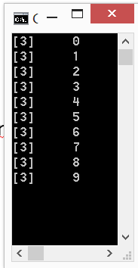
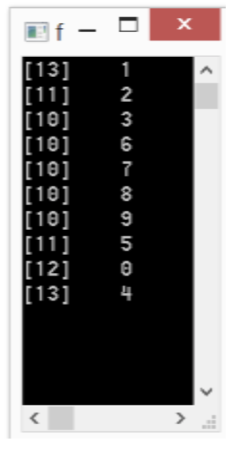
TPL Dataflow Parallelism
var actionBlock = new ActionBlock<int>((i) => {
Console.WriteLine($”{Thread.CurrentThread.ManagedThreadId}\t{i}");
});
for (var i = 0; i < 10; i++) actionBlock.Post(i);
actionBlock.Options = new ExecutionDataflowBlockOptions() {
MaxDegreeOfParallelism = 4 }
);
for (var i = 0; i < 10; i++) actionBlock.Post(i);
Notes:
The DOP is used to maneg the block Throttling
The TPL DataFlow really excels at providing a set of configurable properties by which it is possible, with small changes, to control the level of parallelism, the buffer size of the mailbox, and how to process data and dispatch the outputs.

Slide 21
TransformBlock<T, R>
Func<TInput,TOutput>
Notes:
The TDF TransformBlock block acts like a mapping function, which applies a projection function to an input value and provides a correlated transformed output . The transformation function is passed as an argument in the form of a delegate. The default behavior is to process one message at a time, maintaining strict FIFO ordering.
~~~~~~
By default, this block, like all the others, has the degree of parallelism set to 1. So, no parallel execution. This behavior can be changed by setting the MaxDegreeOfParallelism property in the ExecutionDataflowBlockOptions class.

Slide 22
TransformBlock<T, R>
var tfBlock = new TransformBlock<int, string>( n => { Thread.Sleep(500); return (n * n).ToString(); }, new ExecutionDataflowBlockOptions() {MaxDegreeOfParallelism = 1}); // Change DOP for (int i = 0; i < 10; i++) { tfBlock.Post(i); Console.WriteLine($"Message {i} processed - queue count {actionBlock.InputCount}"); }
Notes:
Int >> string

Slide 23
TransformBlock + ActionBlock
Func<,>
Action<>
Action<>
Notes:
A transform block is generally used in combination with an other block, where it passess the output of the projection as input of the next block.
In this case we can LINK the transform block to one or more action block to generate a side effect.
~~~
As with ActionBlock<TInput>, TransformBlock<TInput,TOutput> enables the execution of a delegate to perform some action for each input; unlike with ActionBlock<TInput>, this processing has an output. This delegate can be a Func<TInput,TOutput>, in which case processing of that element is considered completed when the delegate returns, or it can be a Func<TInput,Task<TOutput>>, in which case processing of that element is considered completed not when the delegate returns but when the returned Task completes. This enables a TransformBlock<TInput,TOutput> to be used with both synchronous and asynchronous methods.
A TransformBlock<TInput,TOutput> buffers both its inputs and its outputs. This output buffer behaves just like a BufferBlock<TOutput>.
As with ActionBlock<TInput>, TransformBlock<TInput,TOutput> defaults to processing one message at a time, maintaining strict FIFO ordering. And as with ActionBlock<TInput>, it may also be configured to process multiple messages concurrently. In doing so, however, it still ensures that output messages are propagated in the same order that they arrived at the block (internally, the block uses a reordering buffer to fix up any out-of-order issues that might arise from processing multiple messages concurrently).

Slide 24
TransformBlock<T, R>
var actionBlock = new ActionBlock<int>(n => { Console.WriteLine($"Message : {n} - Thread Id#{Thread.CurrentThread.ManagedThreadId}"); }); var tfBlock = new TransformBlock<int, int>( n => { return n * n; }, new ExecutionDataflowBlockOptions() {MaxDegreeOfParallelism = 1}); // Change DOP tfBlock.LinkTo(actionBlock);
for (int i = 0; i < 10; i++) { tfBlock.Post(i); Console.WriteLine($"Message {i} processed - queue count {actionBlock.InputCount}"); }
Notes:
LinkTo
The ISourceBlock<TOutput> interface provides a LinkTo method for connecting the source to a target
This extension method provides additional control over linking blocks, such functionality is a predicate applied to a link in order to control what data is propagated across connected blocks
~~~
what links and what the behavior should be applied if the predicate is met

Slide 25
Link Filtering
var actionBlock1 = new ActionBlock<int>(n => { Console.WriteLine($"Message : {n} - Thread Id#{Thread.CurrentThread.ManagedThreadId}"); }); var actionBlock2 = new ActionBlock<int>(n => { Console.WriteLine($"Message : {n} - Thread Id#{Thread.CurrentThread.ManagedThreadId}"); }); var bcBlock = new TransformBlock<int, int>(n => n); bcBlock.LinkTo(actionBlock1);
bcBlock.LinkTo(actionBlock2, n => n % 2 == 0);
Notes:
the LinkTo message filtering can be done by providing a delegate that returns a Boolean value indicating if a message should be offered to the block.

Slide 26
BatchBlock<T>
Notes:
BatchBlock<T> combines a number of items into one batch item, the output is represented as an array of elements.
You define the size of each batch you want, and it will accumulate messages until it reaches that size and then forward it on as an array of messages to the next block asynchronously
~~~
If the block is told no more data will arrive while it still has data pending to form a batch, its last batch will contain the remaining input items.
An instance is created with a specific batch size, and the block then creates a batch as soon as it’s received that number of elements, asynchronously outputting the batch to the output buffer.
Code may also explicitly force a BatchBlock<T> to create a batch from however many items it currently has buffered, even if that’s fewer than the batch size.
BatchBlock<T> is capable of executing in both greedy and non-greedy modes. In the default greedy mode, all messages offered to the block from any number of sources are accepted and buffered to be converted into batches. In non-greedy mode, all messages are postponed from sources until enough sources have offered messages to the block to create a batch. Thus, a BatchBlock<T> can be used to receive 1 element from each of N sources, N elements from 1 source, and a myriad of options in between.
BatchBlock<T> is also capable of tracking the number of batches that have been created. When configured as such, after receiving enough data to create a number of batches equal to that specified to its constructor, BatchBlock<T> will decline all further data offered to it.

Slide 27
BatchBlock<T>
// Batching Requests into groups of 100 to Submit to a Database var batchRequests = new BatchBlock<Request>(batchSize:100);
var sendToDb = new ActionBlock<Request[]>(reqs => SubmitToDatabase(reqs));
batchRequests.LinkTo(sendToDb);
for (int i = 0; i < 100; i++) batchRequests.Post(new Request (i));
Notes:
we create a batch block that will batch messages of type request into batches of 100. Then, we send 100 messages into the block in a for loop

Slide 28
BatchBlock<T>
request
request
request
request
Bottleneck
request
request
request
Multiple application requests for Database
Contention due to a limited number of available connections, causing waits and queuing of the requests
The number of concurrent requests is reduced
Notes:
When talking about performance, one of the easiest ways is to start batching our operations. For example database operations
So this block could be used in isolation to perform operations in batches

Slide 29
BroadcastBlock<T>
“overwrite buffer”
Notes:
The BroadcastBlock<T> is useful when you must pass multiple messages to another component or multiple components.
The BoroadcastBlcok consists of a buffer of one message and a Func<T, T> delegate. The buffer gets overwritten on each new incoming message. The delegate is simply for giving you control of how to clone the message. Message transformation is not possible. The block can be linked to multiple blocks to enable branching of the pipeline.
~~~~
Although it only buffers one message at a time, it will always forward that message on to linked blocks (if they have buffer capacity).

Slide 30
BroadcastBlock<T>
var bcBlock = new BroadcastBlock<int>(n => n); var actionBlock1 = new ActionBlock<int>(n => Console.WriteLine($"Message {n} processed - ActionBlock 1")); var actionBlock2 = new ActionBlock<int>(n => Console.WriteLine($"Message {n} processed - ActionBlock 3")); bcBlock.LinkTo(actionBlock1); bcBlock.LinkTo(actionBlock2);
for (int i = 0; i < 10; i++) bcBlock.Post(i);
Notes:
This is what the broadcast block does. Its uniqueness is in the fact that it sends the message to all linked consumers.
The broadcast block constructor requires providing a cloning function. When talking about TPL Dataflow, I'm talking about messages, but remember that all processing is happening in memory. If messages are objects they will be passed to functions as reference types. This means that a message can be delivered to multiple consumers then that is the same instance of the message. It's one of the reasons why I always return a new message using the cloning function. Never mutate the state of the message.

Slide 31
Completion and Error propagation
var source = new BufferBlock<string>(); var actionBlock = new ActionBlock<string>(n => { Console.WriteLine($"Message : {n} - Thread Id#{Thread.CurrentThread.ManagedThreadId}"); }); // Completation is not propagated by default source.LinkTo(actionBlock, new DataflowLinkOptions() { PropagateCompletion = true });
for (int i = 0; i < 10; i++) { source.Post($"Item #{i}"); } actionBlock.Completion.ContinueWith(a => Console.WriteLine("actionBlock completed")); source.Complete(); actionBlock.Completion.Wait();
Notes:
Because the TPL Dataflow is message based, we are awaiting for message posting, but we aren't awaiting for further processing.
To fix this issue we need to wait for the last block to complete. Each TPL Dataflow block exposes a Completion property, which it represents the block's lifecycle.
We should signal completion just after we are done sending all the messages to the first buildoig block
To enable completion propagation we have to turn on the PropagateCompletion property that is located in the DataflowLinkOptions
~~~
Finally, the workflow processed all messages and completed properly. We managed to complete our workflow. But remember that completing a
workflow means that you can't use it anymore. Messages sent to a completed block are ignored.

Slide 32
Building a Dataflow Network
Internal Buffer
Task
transf1.LinkTo(join);
transf2.LinkTo(join);
Input Buffer
Task
Output Buffer
Input Buffer
Internal Buffer
Task
Task
Output Buffer
Input Buffer
Task
Output Buffer
Buffer.LinkTo(action);
Buffer.LinkTo(transf1);
Buffer.LinkTo(transf2);
Notes:
There are about 14 different building blocks to implement any sort of complex scenario.
In advance cases, you can implement your own

Slide 33
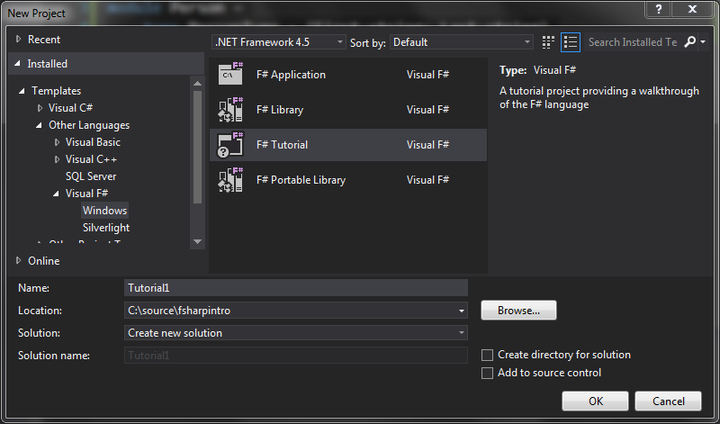


Slide 34
Parallel Web-Crawler

Slide 35
A TPL Dataflow based WebCrawler
TPL Dataflow
Block
Download
Web Page
TPL Dataflow
Block
TPL Dataflow
Block
TPL Dataflow
Block
Image Parser
Broadcast
Broadcast
Download web pages asynchronously.
Download max 4 web pages in parallel.
Traverse the web pages links tree.
Parse for links to images.
Download jpg images to disk.
Download the images using async
(parallel async stream copy)
Link Parser
TPL Dataflow
Block
TPL Dataflow
Block
Image Processor
(Write to disk)
Local
File
Notes:
Tpl Dataflow application is usually a collection of blocks which is linked together in order to compose a complete solution.
Downloader: the responsibility of the downloader is to download the html of a web page. It takes a url as input and it produces the related page’s html as output.
Link-parser: analyzes the downloaded html to look for links elements <a href="…"/>
Image-parser: analyzes the downloaded html to look for image elements <image src="…"/>
Broadcast: the broadcast block is construct from an input and output of single item linking one or more agents
Link-together (broadcast): linking the block to each other
Writer: persists the image and/or produce a side effect
the downloader should be link to the content broadcaster which in tern should be linked both to the image and link parser, the image parser should be linked to the writer and the link parser should be linked back to the downloader (so it can crawl farther)

Slide 36
Reactive Extensions
Notes:
If you are familiar with RX you might have notice some similarities with the TPL Dataflow. The main difference is that Rx focuses on the coordination and the composition of event streams with a LINQ-based API, providing a set of combinators for manipulating IObservable<T>s of data. In contrast, TPL Dataflow is focused on providing building blocks for message passing and parallelizing CPU and I/O-intensive applications with high-throughput and low-latency, while also providing explicit control over how data is buffered.
It turned out that these technologies provide a great deal together. (In fact, TPL Dataflow includes built-in conversions that allow its “dataflow blocks” to be exposed as both observables and observers, enabling direct integration with RX.)

Slide 37
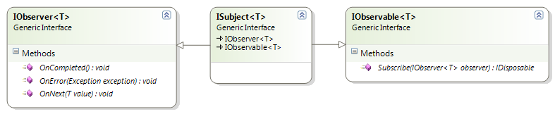
What are Reactive Extensions
Rx is a library for composing asynchronous and event-based programs using observable sequences and LINQ-style query operators
Notes:
What is RX?
The Reactive Extensions (Rx) is a library for composing asynchronous and event-based programs using observable sequences and LINQ-style
Rx allows to query data-in-motion as stream of events by composing operators to create queries and to compose sequences to enrich the data.
Rx is based on the IObserver<T> and IObservable<T> interfaces that provide a mechanism for push-based notification
This is in opposition of the ienumerable interface which is pooled based. You have to ask for some data… but what about if data are not there? It seems very synchrous… on the other side RX pushes the data from the source to the consumer async without blocking

Slide 38
The IEnumerable\IEnumerator pattern pulls data from source, which blocks the execution if there is no data available
Interactive
Reactive
The IObservable\IObserver pattern receives a notification from the source when new data is available, which is pushed to the consumer
Data
Source
Data
Source
Pushing
MoveNext()
Pulling
IEnumerable<T>
IEnumerator<T>
IObservable<T>
IObserver<T>
The consumer asks for new data
The source notifies the consumer that new data is available
OnNext()
Consumer
Consumer
Notes:
Push vs Pull model. Where the IObservable/IObserver instead of asking for data (as in pooling data), it receives a notification when new data is available to send to the consumer.
So Reactive Extensions is like LINQ, but in reverse
~~
The ReactiveX Observable model allows you to treat streams of asynchronous events with the same sort of simple, composable operations that you use for collections of data items like arrays
~~~
This stems from the fact that IObservable is IEnumerable’s mathematical dual – where an IEnumerable collection is a pull collection, IObservable is a push collection. They are equal and opposite. Instead of requesting each item from the collection as you would with an IEnumerable, an IObservable gives you a notification every time it receives a new item, and another notification when it reaches the end of the collection.
Hold on – what does all this have to do with parallelism? Well, Rx goes hand in hand with the parallelism constructs available because it allows us to combine asynchronous sources together to compose our application. These asynchronous sources could be the output from some separate, parallel computations – or something more basic like UI events (on a different thread). It handles all of the complexity involved in cross-thread issues for us and allows us to focus on composition.
Developers now have access to more streaming data than ever before. Much of this data originates from sensors connected to the Internet. These sensors continually post the data they collect.Mukherjee, Sudipta (2014-11-26). Thinking in LINQ: Harnessing the Power of Functional Programming in .NET Applications (Kindle Locations 6303-6304). Apress. Kindle Edition.
“GitHub for Windows uses the Reactive Extensions for almost everything it does, including network requests, UI events, managing child processes [...] while still having 100% deterministic, reliable unit tests. The desktop developers at GitHub loved Rx so much, that the Mac team created their own version of Rx and ReactiveUI, called ReactiveCocoa, and are now using it on the Mac to obtain similar benefits.”
Paul Betts, GitHub
The IObserver<T> and IObservable<T> interfaces provide a generalized mechanism for push-based notification, also known as the observer design pattern
The Ienumerable interface has base problem.. It is pooled based. You have to ask for some data… but what about if data are not there? It seems very synchrous
IObservable<T> is meant to be the "functional dual of IEnumerable<T>”
~~~~~~~~ Mathematical Duality, what duality means… it means that if buy one thing… you get one other thing for free.
More specifically , if you know one thing you can infer and know the one other thing too… the opposite ☺
In this case we know what and Ienumerable is, and we know it is used to iterate a collection in a polled base fashion, which is not great… can be stacked.. synchroucity …an so .. But, because we know what Ienumerable is, we can infer the dual… the opposite of Ienumerable to have a pushed based notification system.. That is telling us when something is ready to take and compute versus us ask for something that it might be no there… the Hollywood principle
Object Expression
RX comes with many many tools in it's arsenal, such as
2 core interfaces IObservable / IObserver
Lots of LINQ like extension methods for IObservable
Time / window based operations (LINQ doesn't really have these)
Concurrency schedulers
Stream error handling controls (Catch etc etc)
Ability to create IObservable from a great many other things, such as
IEnumerable
Task
Events
IObservable Factories
~~~~~~~~
. The IObservable<T> interface represents the class that sends notifications (the provider); the IObserver<T> interface represents the class that receives them (the observer). T represents the class that provides the notification information.
An IObserver<T> implementation arranges to receive notifications from a provider (an IObservable<T> implementation) by passing an instance of itself to the provider's IObservable<T>.Subscribe method. This method returns an IDisposable object that can be used to unsubscribe the observer before the provider finishes sending notifications.
The IObserver<T> interface defines the following three methods that the observer must implement:
The OnNext method, which is typically called by the provider to supply the observer with new data or state information.
The OnError method, which is typically called by the provider to indicate that data is unavailable, inaccessible, or corrupted, or that the provider has experienced some other error condition.
The OnCompleted method, which is typically called by the provider to indicate that it has finished sending notifications to observers.
Further reading : http://msdn.microsoft.com/en-us/library/dd783449(v=vs.110).aspx
IObserver<T> IObserver<T> is the other one of the two core interfaces for working with Rx. It too has made it into the BCL as of .NET 4.0. Don't worry if you are not on .NET 4.0 yet as the Rx team have included these two interfaces in a separate assembly for .NET 3.5 and Silverlight users. IObservable<T> is meant to be the "functional dual of IEnumerable<T>". If you want to know what that last statement means, then enjoy the hours of videos on Channel9 where they discuss the mathematical purity of the types. For everyone else it means that where an IEnumerable<T> can effectively yield three things (the next value, an exception or the end of the sequence), so too can IObservable<T> via IObserver<T>'s three methods OnNext(T), OnError(Exception) and OnCompleted().
The OnNext method, which is typically called by the provider to supply the observer with new data or state information.
The OnError method, which is typically called by the provider to indicate that data is unavailable, inaccessible, or corrupted, or that the provider has experienced some other error condition.
The OnCompleted method, which is typically called by the provider to indicate that it has finished sending notifications to observers.
Rx has an implicit contract that must be followed. An implementation of IObserver<T> may have zero or more calls to OnNext(T) followed optionally by a call to either OnError(Exception) or OnCompleted(). This protocol ensures that if a sequence terminates, it is always terminated by an OnError(Exception), or an OnCompleted(). This protocol does not however demand that an OnNext(T), OnError(Exception) or OnCompleted() ever be called. This enables to concept of empty and infinite sequences. We will look into this more later.

Slide 39
TPL Dataflow & Reactive Extension
IPropagatorBlock<int, string> source =
new TransformBlock<int, string>(i => (i + i).ToString());
IObservable<int> observable = source.AsObservable().Select(int.Parse);
IDisposable subscription =
observable.Subscribe(i => $"Value {i} - Time
{DateTime.Now.ToString("hh:mm:ss.fff")}".Dump());
for (int i = 0; i < 100; i++)
source.Post(i);
Notes:
The TPL DF provides points of integration with RX and the IObservable and IObserver interfaces
The most straightforward combination of Rx and TDF involves transforming the output of a source block into an observable sequence by using the AsObservable. This allows construction of an arbitrary Dataflow chain that just needs to have some propagating at the end. This output can then flow into the Reactive fluent extension methods to further process the output. This generally terminates with a Subscribe call to executes some action on the resulting data.

Slide 40
TPL Dataflow & Reactive Extension
IPropagatorBlock<string, int> target =
new TransformBlock<string, int>(s => int.Parse(s));
IDisposable link = target.LinkTo(new ActionBlock<int>(i => $"Value {i} - Time
{DateTime.Now.ToString("hh:mm:ss.fff")}".Dump()));
IObserver<string> observer = target.AsObserver();
IObservable<string> observable = Observable.Range(1,20)
.Select(i => (i *i).ToString());
observable.Subscribe(observer);
for (int i = 0; i < 100; i++)
target.Post(i.ToString());
Notes:
A transformation in the opposite direction is also possible using the AsObserver extension method allows a TDF chain to make itself available for input as an IObserver instance. Since IObserver can be used directly as an IObservable Subscribe target, any Rx sequence can set up a subscription to flow its data into the target block.
~~~~
The integration doesn’t feel quite as smooth in this direction due to the need for setup of the target block ahead of the subscription but it’s still a pretty clean switch.
An extension method that creates an IObserver<T> for an ITargetBlock<T>. OnNext calls on the observer will result in the data being sent to the target, OnError calls will result in the exception faulting the target, and OnCompleted calls will result in Complete called on the target.

Slide 41
TPL DataFlow and Rx
var encryptor = new TransformBlock<CompressDetails, EncryptDetails>();
inputBuffer.LinkTo(compressor, linkOptions);
compressor.LinkTo(encryptor, linkOptions);
encryptor.AsObservable()
.Scan((new Dictionary<int, EncryptDetails>(), 0),
(state, msg) => Observable.FromAsync(async() => {
(Dictionary<int,EncryptDetails> details, int lastIndexProc) = state;
details.Add(msg.Sequence, msg);
return (details, lastIndexProc);
}) .SingleAsync())
.SubscribeOn(TaskPoolScheduler.Default).Subscribe();
Notes:
State

Slide 42
Notes:
Words Counter
OR
DataFlowPipeline

Slide 43
TPL Dataflow Agent in .NET
Action
Process 1
Process 2
Process 3
Process 4

Slide 44
Agent anatomy
Processing
Storage – State
Communication only by messages
Share Nothing
Message are passed by value
Lightweight object
Running on it’s own thread
No shared state
Messages are kept in mailbox and processed in order
Massively scalable and lightening fast because of the small call stack
Immutable state
A message is sent to the mailbox to communicate with the Agent
Agent
Mailbox
queue
State
Incoming message
Behavior
(Message processor)
Output
message
Messages are dequeued and processed sequentially
Single threaded
Encapsulate state
Notes:
An Agent is an independent computational entity which contains a message queue, and that it reacts when receives a messages and processes it
An Agent is composed by a Mailbox, Behavior and state.
The TPL DF fits quite well in this model, but one thing is missing, the state, an isolated state. Where the state can be access only by the agent it self or by messages
~~~
Conceptually an Agent has its own “thread” of execution, and it is also both asynchronous and BUFFEREDl.
The Actor model provides immutability and isolation which are the more important characteristic to write lock and bug free concurrent program
The Isolation is forced through message passing
~~~
An agent consists of a mailbox that queues the income messages, a state, and a behavior that runs in a loop, processing one message at a time
Mailbox: an internal queue to buffer incoming messages implemented as asynchronous, race-free, and non-blocking
Behavior: the internal function applied sequentially to each incoming message. The behavior is single-thread
State: Agents could have an internal state that is isolated and never shared, so they never need to compete for locks to be accessed
Message: Agents can communicate only through messages, which are sent asynchronously and are buffered in a mailbox

Slide 45
TPL DataFlow a statefull Agent in C#
class StatefulDataflowAgent<TState, TMessage> : IAgent<TMessage>
{
private TState state;
private readonly ActionBlock<TMessage> actionBlock;
public StatefulDataflowAgent(
TState initialState,
Func<TState, TMessage, Task<TState>> action,
CancellationTokenSource cts = null)
{
state = initialState;
var options = new ExecutionDataflowBlockOptions
{
CancellationToken = cts != null ?
cts.Token : CancellationToken.None
};
actionBlock = new ActionBlock<TMessage>(
async msg => state = await action(state, msg), options);
}
public Task Send(TMessage message) => actionBlock.SendAsync(message);
public void Post(TMessage message) => actionBlock.Post(message);
}
Notes:
Mutation in this case is ok because is isolated

Slide 46
TPL DataFlow as Agent
StatelessAgent
StatefulAgent
Messages
ActionBlock
Messages
ActionBlock
Buffer
Task
State
Buffer
Task
Notes:
subscriber

Slide 47
Notes:
Agent Stocks

Slide 48
contacts
Source https://github.com/rikace/tpl-dataflow
Twitter @trikace
Blog www.rickyterrell.com
Email tericcardo@gmail.com
Github www.github.com/rikace

Slide 49

Q & A ?
The tools we use have a profound (and devious!) influence on our thinking habits, and, therefore, on our thinking abilities.
-- Edsger Dijkstra

Slide 50


How to reach me
github.com/DCFsharp meetup.com/DC-fsharp/ @DCFsharp rterrell@microsoft.com

